Slide 1
Kupongo Overview
Kupongo Team

Slide 2
Overview / MVP
Goal:
New Approach to coupon collecting
Four Core Features:
Executive UI:
Allow a company to create a coupon
Allow a company to anchor the coupon to a geographic location.
Customer UI:
Allow a customer to collect the coupon at the anchor point.
Allow a customer to redeem the coupon.
Notes:
Melvin: I’ll get things started with a general overview of the project

Slide 3
Initial Approach
Database considerations:
Normal relational database which everyone is familiar with?
NoSQL, non-relational database that can handle different types of data?
Server Considerations:
Must play well with our database choice.
How will it communicate with our front-end?
Application considerations:
Designed using standard web/application languages?
Use different tools that allow greater customization?
Notes:
Preston: I’ll take this slide if no one else wants it.
Need to add more about how we approached the idea.

Slide 4
Refined Approach
Database:
MongoDB vs MySQL
MongoDB:
NoSQL
Document-oriented
Allows Sharding for high/geographically spaced throughput
MySQL:
Familiar to most
Row-Column based
Notes:
I will handle presenting this slide - Kevin M

Slide 5
Refined Approach
Server-Side API Interface:
Node.js VS. Python/Django
Node.js:
Works very well with MongoDB
Very fast for tasks that aren’t computationally heavy
Extensive Documentation
Python/Django
Works very well with SQL
Easy to use / Easy to learn
Extensive documentation
Notes:
I will take this slide too - Kevin M

Slide 6
Refined Approach cont.
Application:
React/React Native vs Angular vs Meteor
React/React Native:
Compile native application components
Reuse code components
High performing UI layer
Angular:
Model-View-Control architecture
Two-way data binding
Mobile first approach
Meteor
Able to deploy to mobile easily using PhoneGap/Cordova.
Cuts workload by writing one client application.
Notes:
David - I’ll take this slide too.

Slide 7



Tech Stack Overview
Node.JS server for API
Used to handle queries to Mongo and complex logic involving them.
MongoDB server for models
Holds Coupons, Users, etc.
Making use of their Geospatial queries
Client (Mobile/Web) - React and React Native
Mostly front-end.
Most logic will be handled through API calls.
Notes:
David - I’ll take this slide

Slide 8
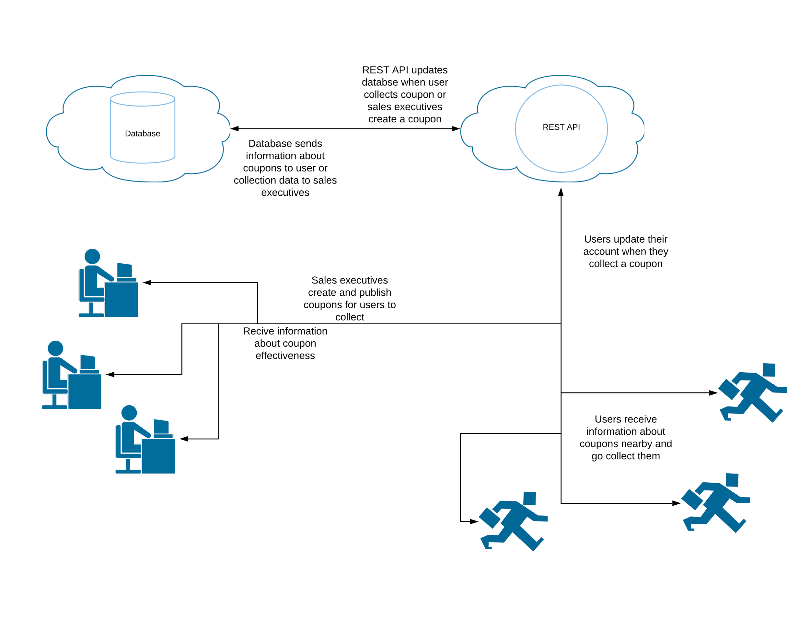
Big Picture

Slide 9
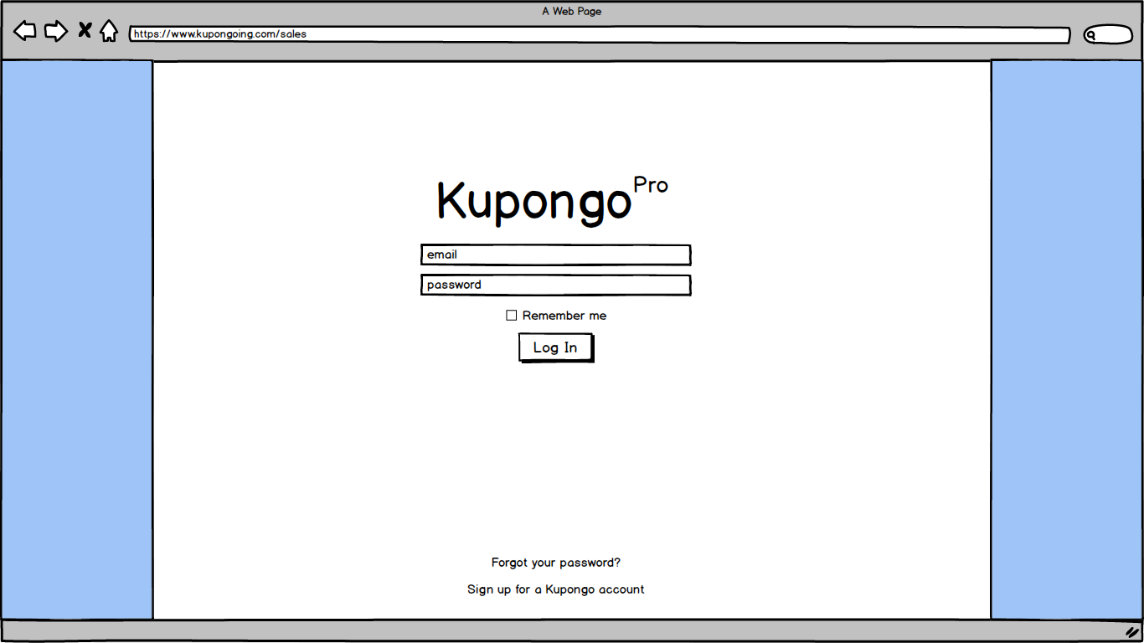
Basic User Interface (Sales) Sign In Page
Notes:
Business validation rules needed for authorizing a sales account (register a business entity)

Slide 10
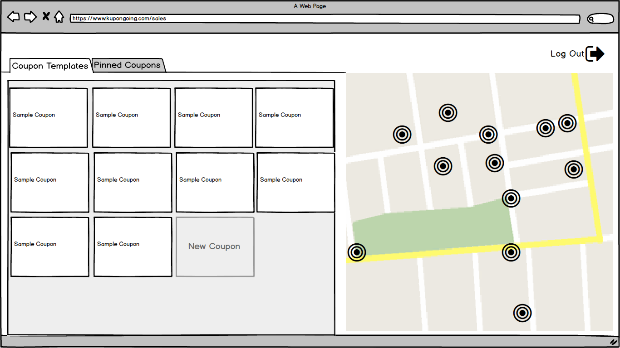
Basic User Interface (Sales) Coupon Templates
Notes:
Hidden Functions on this page:
Double clicking on the thumbnails will pop up a a detail window in which the coupon information can also be edited
Hold Shift and click one or more templates followed by one or more locations on the map with open a dropdown prompt asking the user to confirm or
Cancel the pins.
Click New Coupon button to open a new template detail edit window.

Slide 11
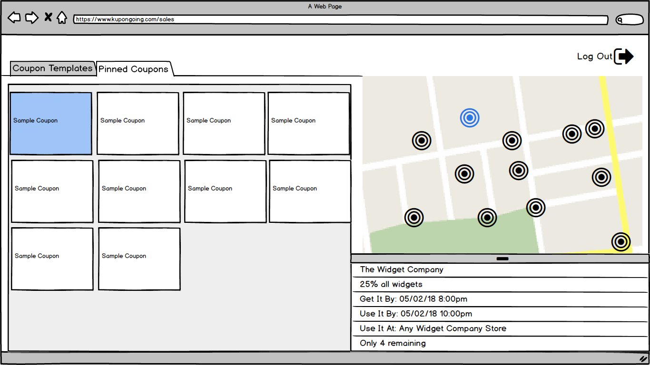
Basic User Interface (Sales) Pinned Coupons
Notes:
Same functionality on this page minus the pinning (they are already pinned)
Note that a single click will also open a summarized detail view in the bottom right corner (not for editing).

Slide 12
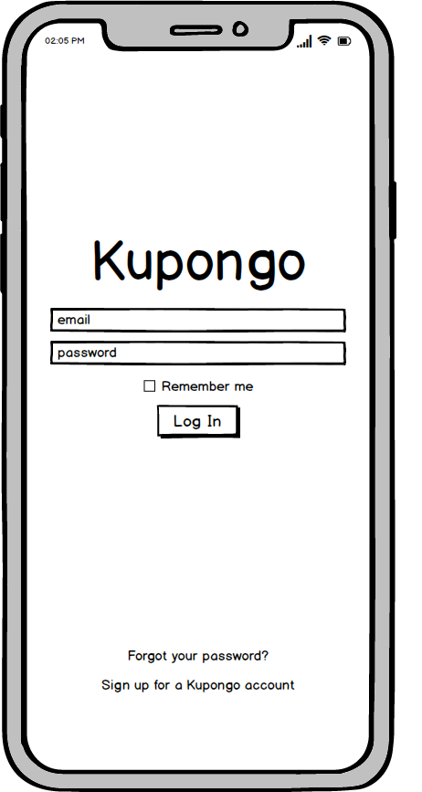
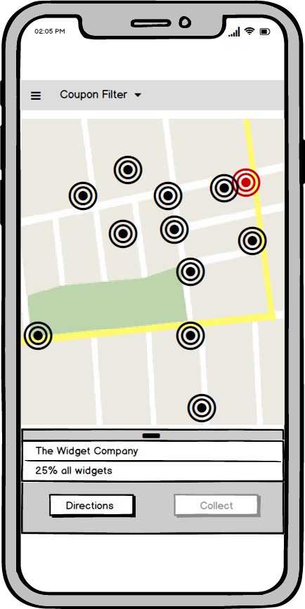
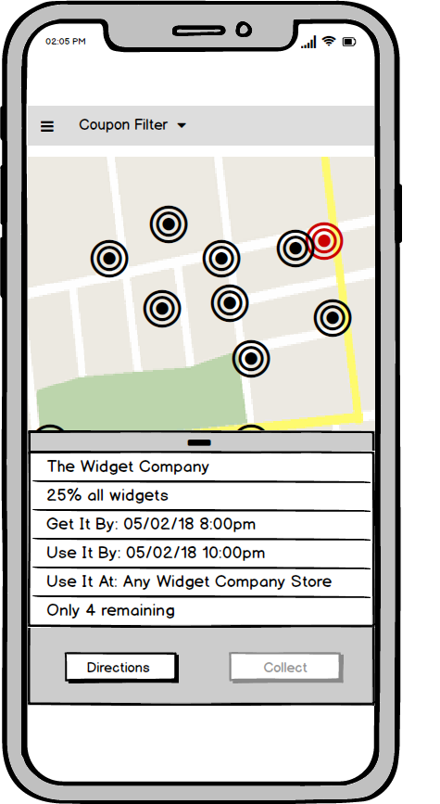
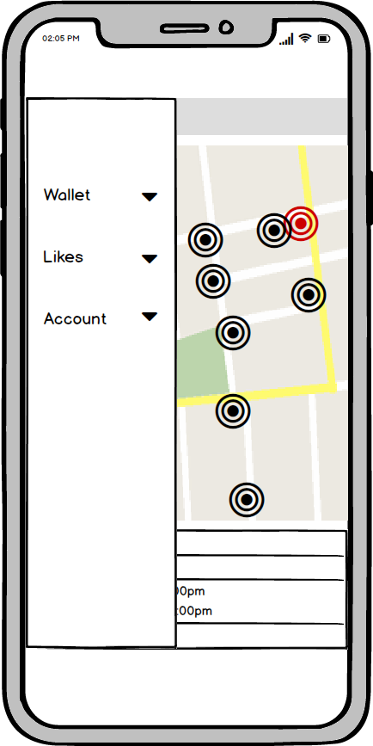
Basic User Interface (Customer)
Notes:
From left to right, customer sign in, home page, coupon detail, and side nav,
Note that the collection button is disabled until the user is close enough the the pinned location.
Coupons can be filtered by the users like categories.

Slide 13
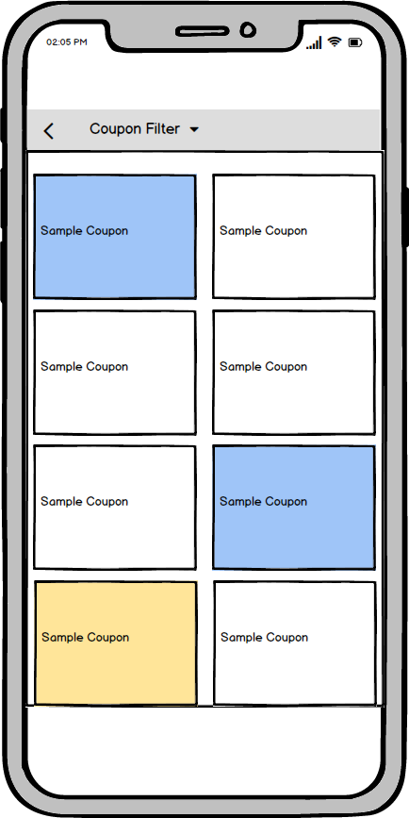
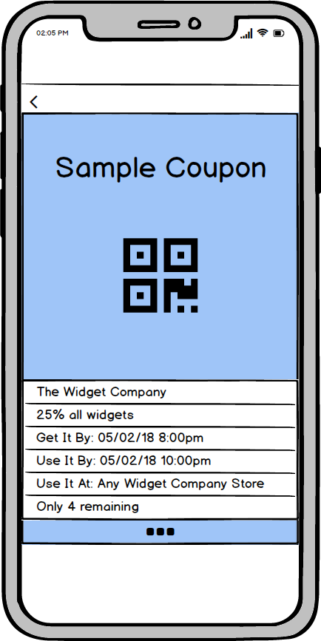
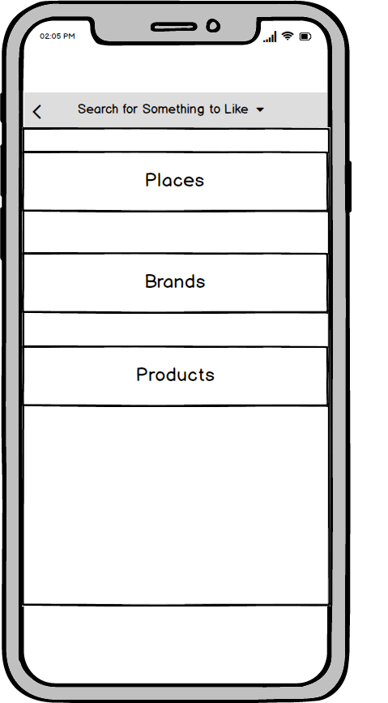
Basic User Interface (Sales)
Notes:
From left to right, customer wallet (of collected coupons ready to redeem), coupon detail view (with QR code ready to scan), and Likes Nav Page
Note: each Like category opens its own list page.
User can search for Places (Physical businesses), Brands (generalized businesses), or products to like ( could add services)

